Slide 1
Capstone Management

Slide 2
Problem listing

Slide 3
Project Goal

Slide 4
Project requirement

Slide 5
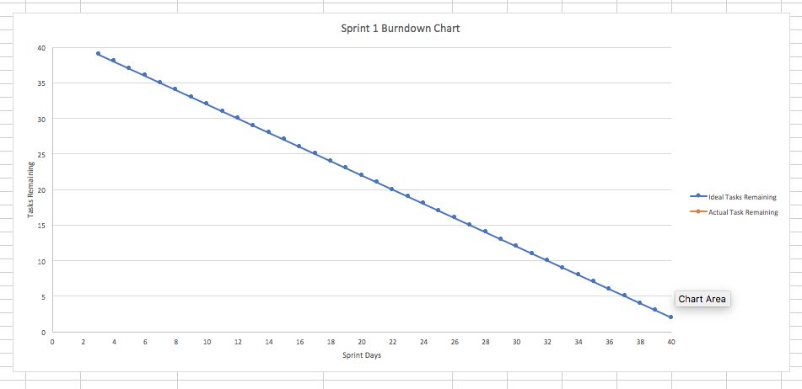
Project feasibility - Sean

Slide 6
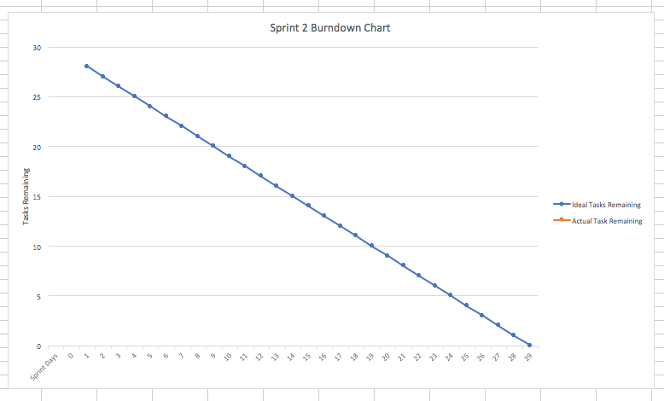

Slide 7
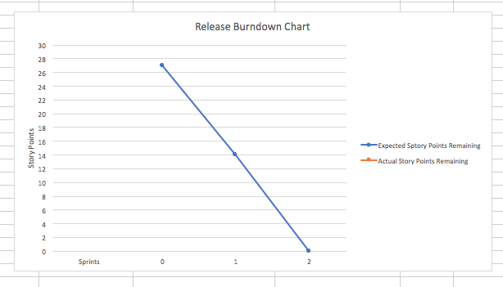

Slide 8
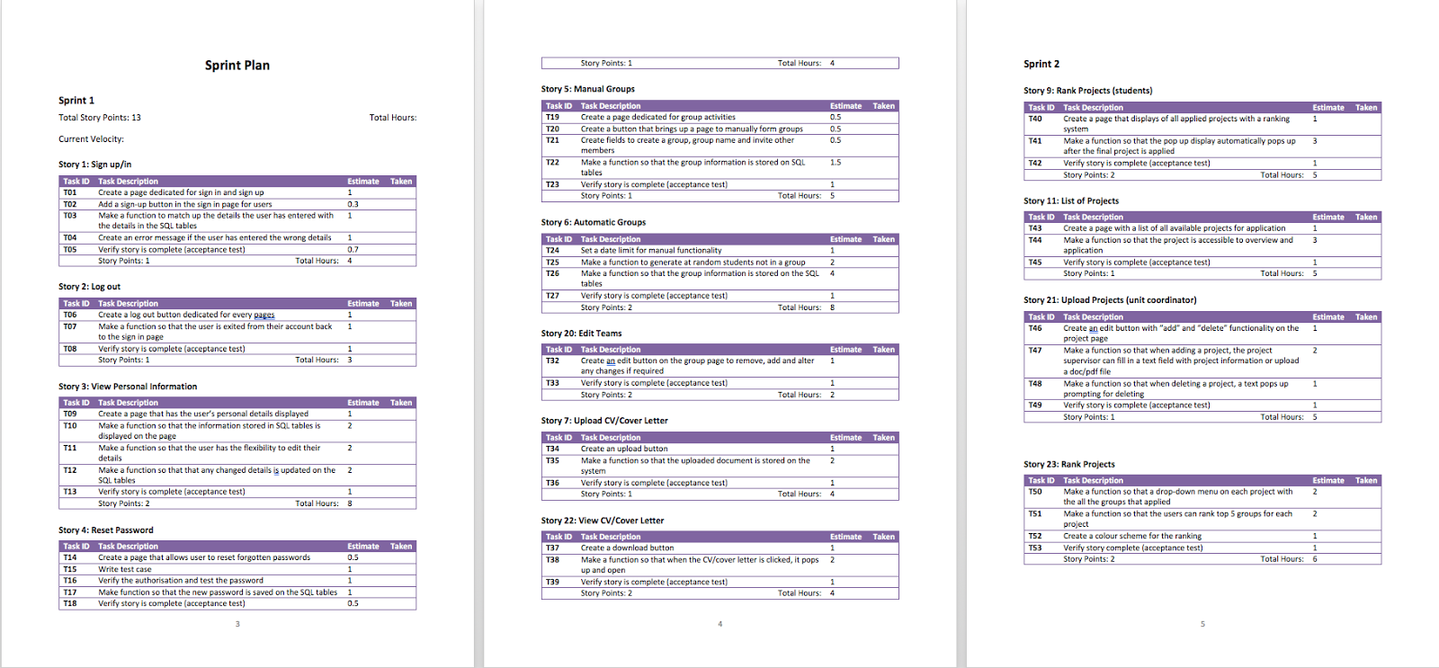
Project Plan - Sean

Slide 9
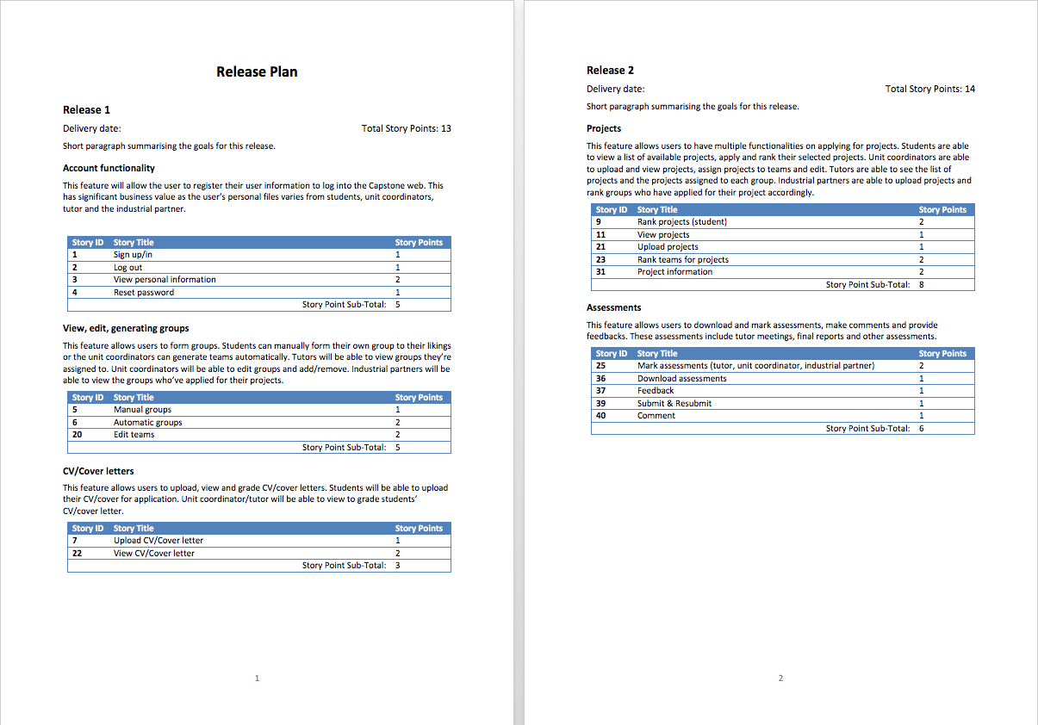

Slide 10
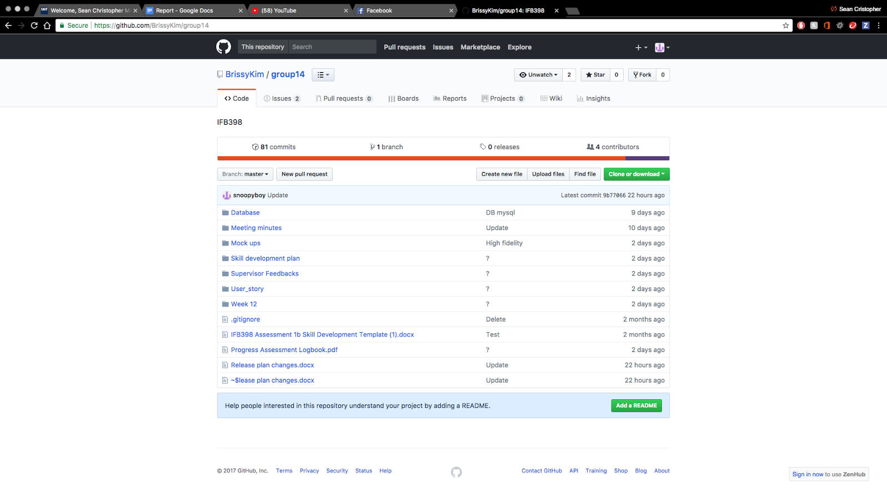
Project management - Sean

Slide 11
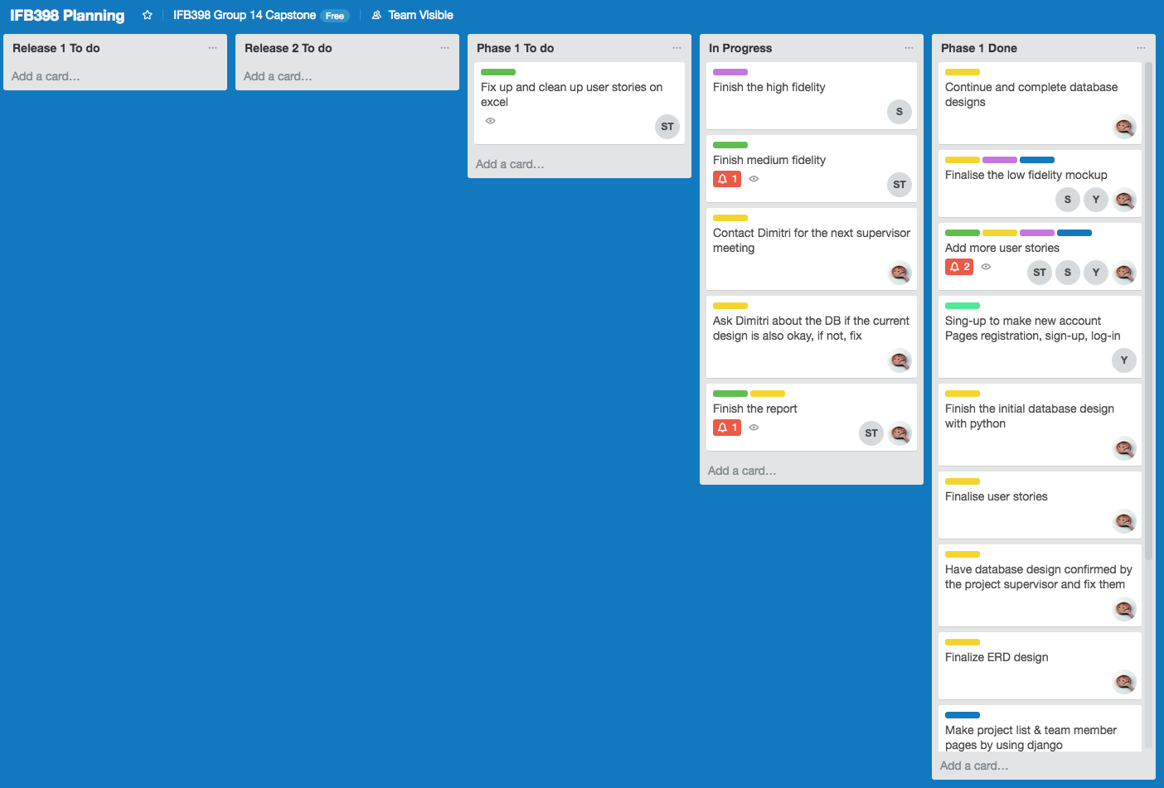

Slide 12
Project Design
Why python and Django
Database Design
Low/Med/High Fidelity

Slide 13
Why python and Django
PYTHON AND DJANGO ARE HUGE IN FINTECH
IT HAS A TON OF RESOURCES
DJANGO, A HIGH-LEVEL PYTHON WEB FRAMEWORK, IS FLAT-OUT AMAZING

Slide 14
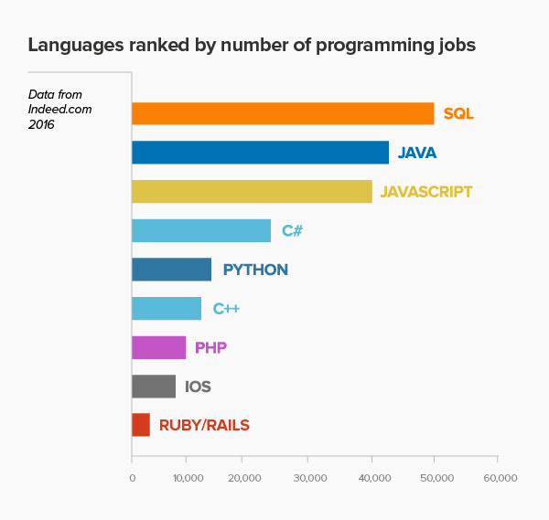
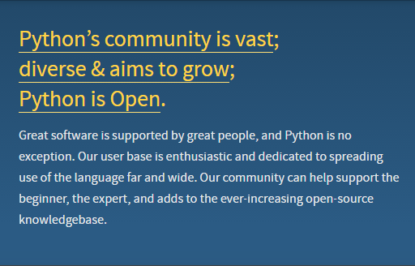
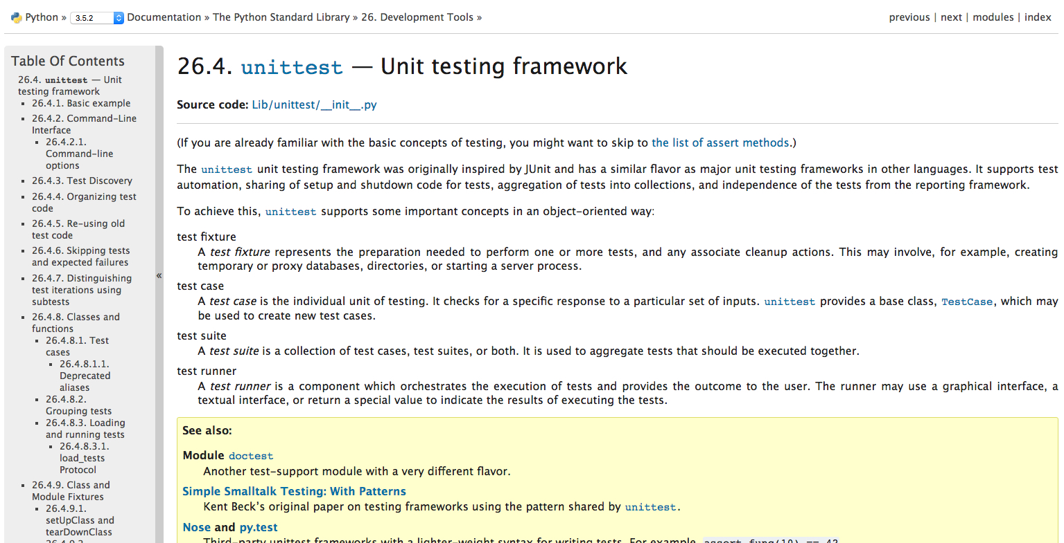
Huge COMMUNITY AND A TON OF RESOURCE

Slide 15
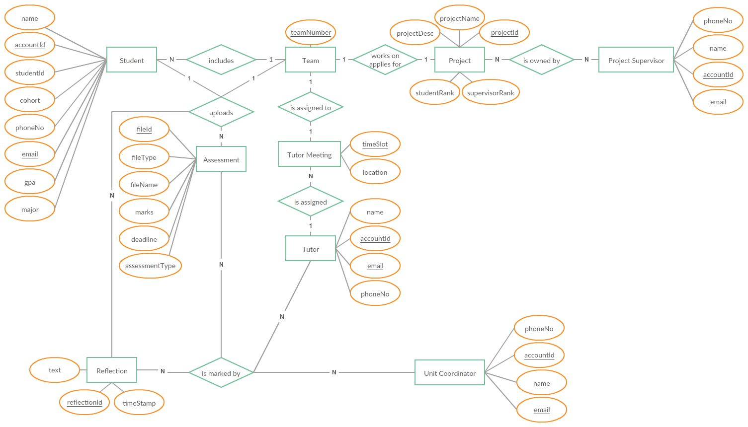
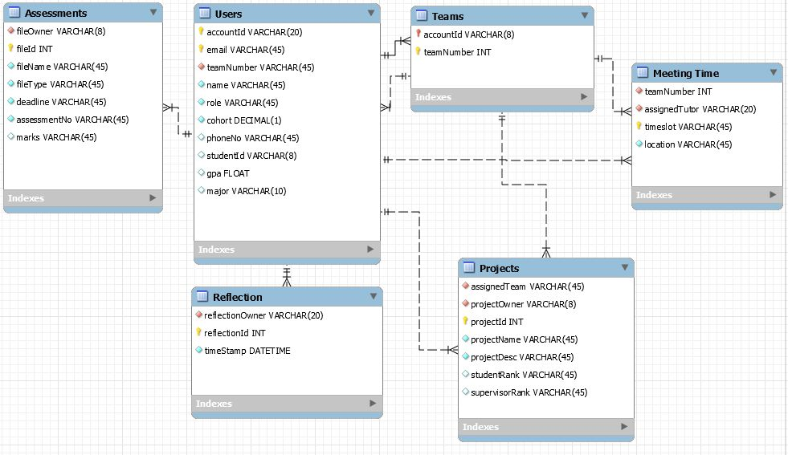
How to make Database Design
Entity Relationship Diagram
Database Tables

Slide 16
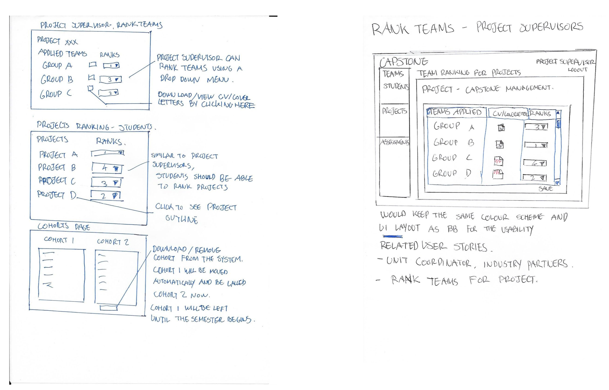
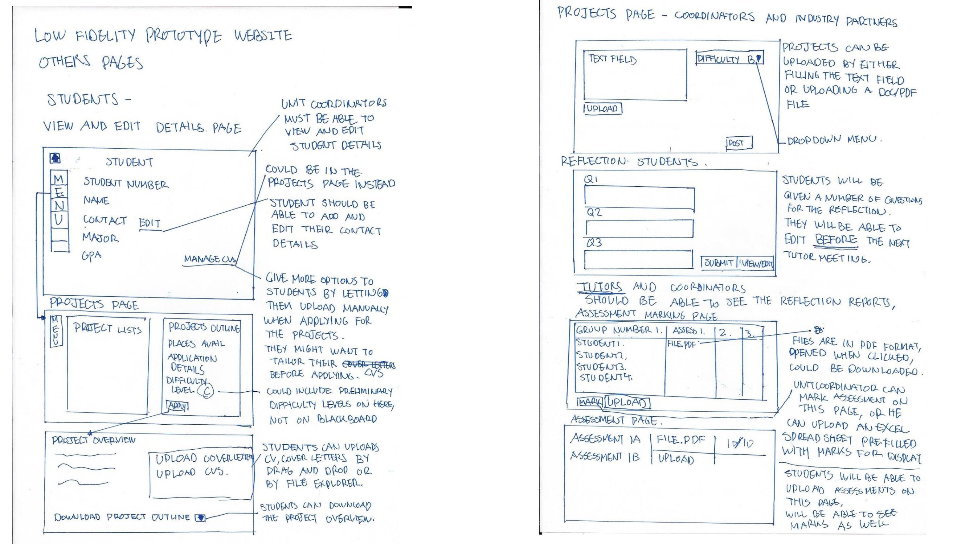
Low Fidelity

Slide 17
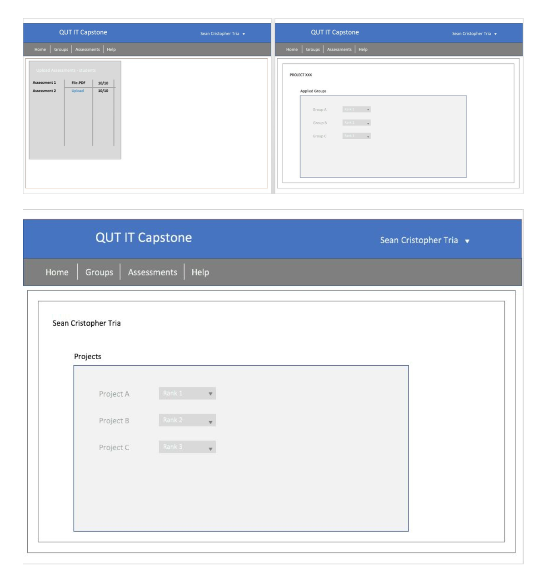
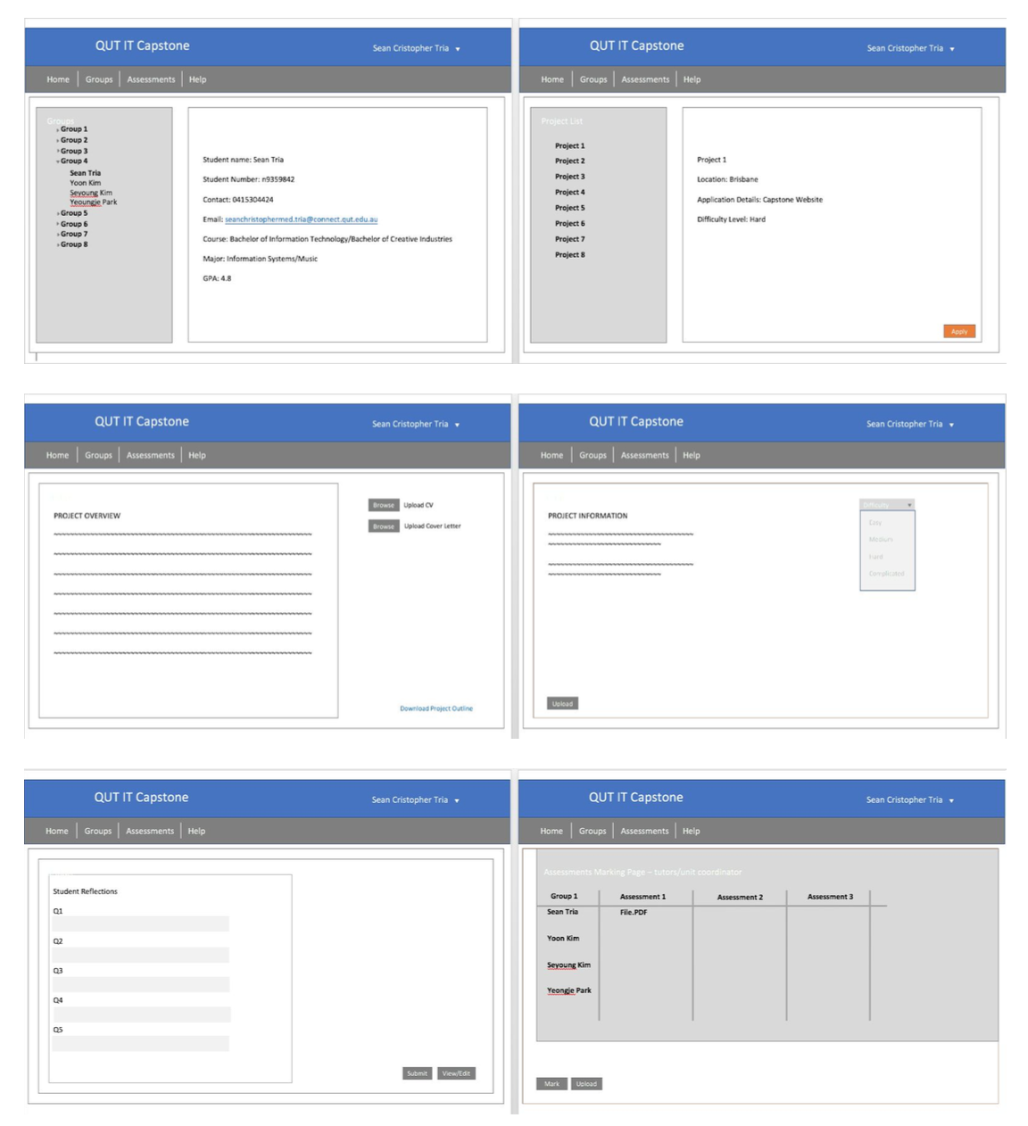
Med Fidelity

Slide 18
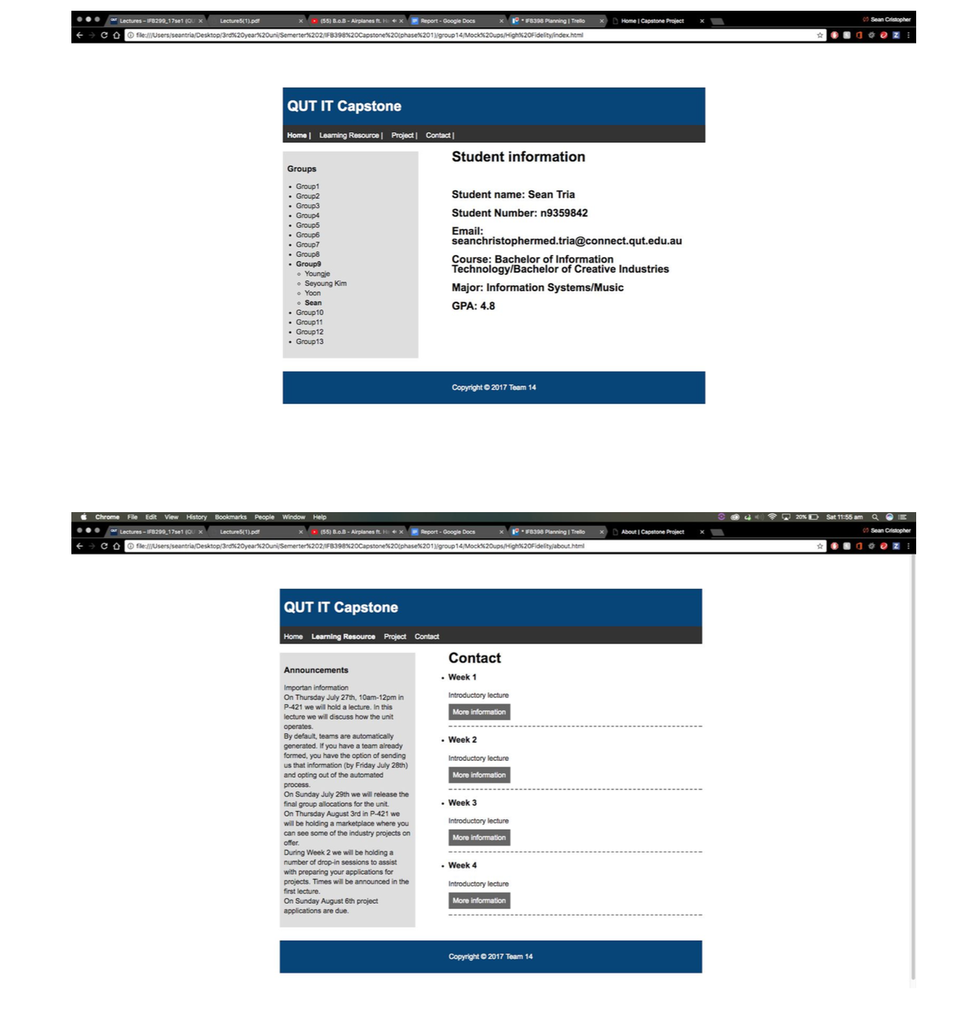
High Fidelity

Slide 19
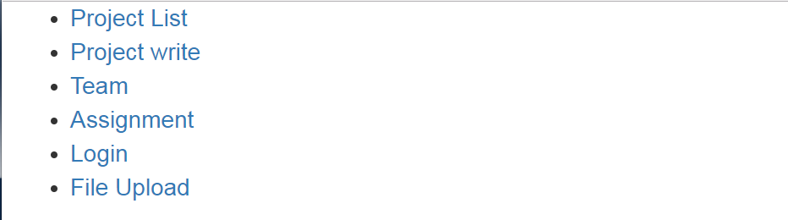
Initial Work and Prototype for web application (Functional prototype pages)
First Page

Slide 20
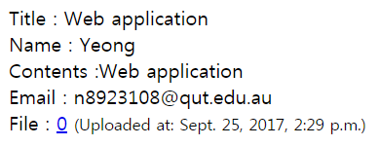
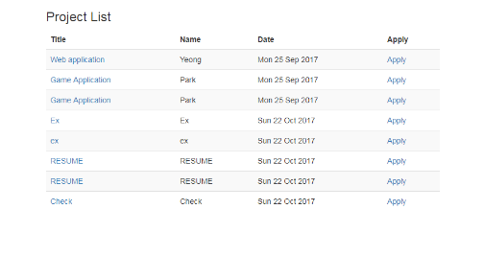
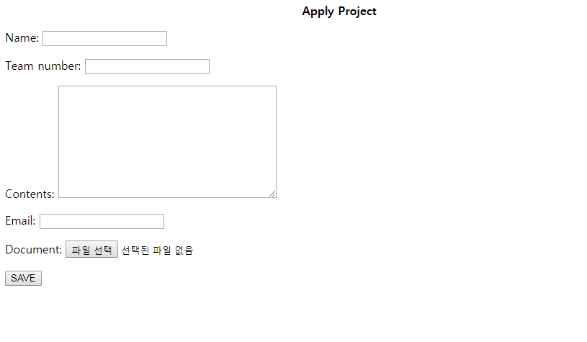
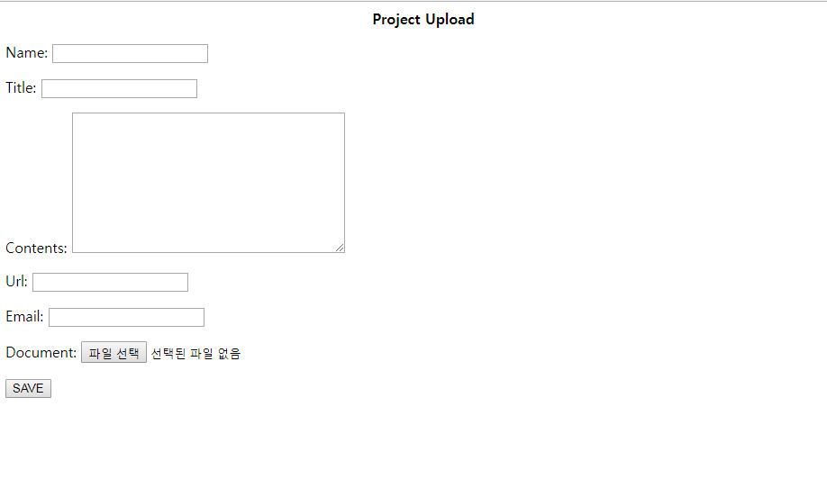
Project Detail
Project List
Project Pages
Project Upload
Apply Project

Slide 21
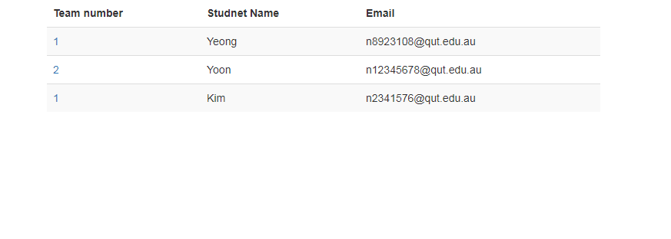
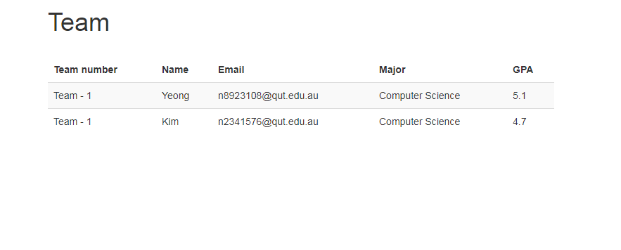
Student Information
Team Member Information
Student & Team Detail

Slide 22
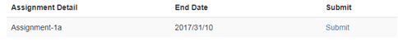
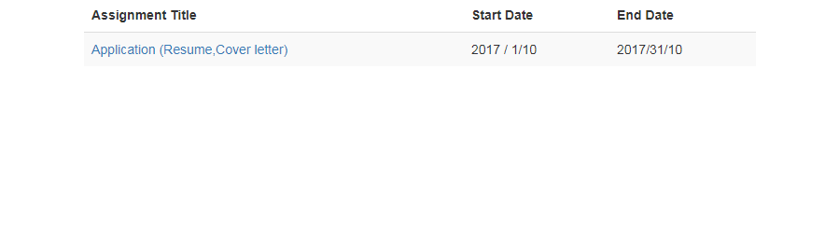
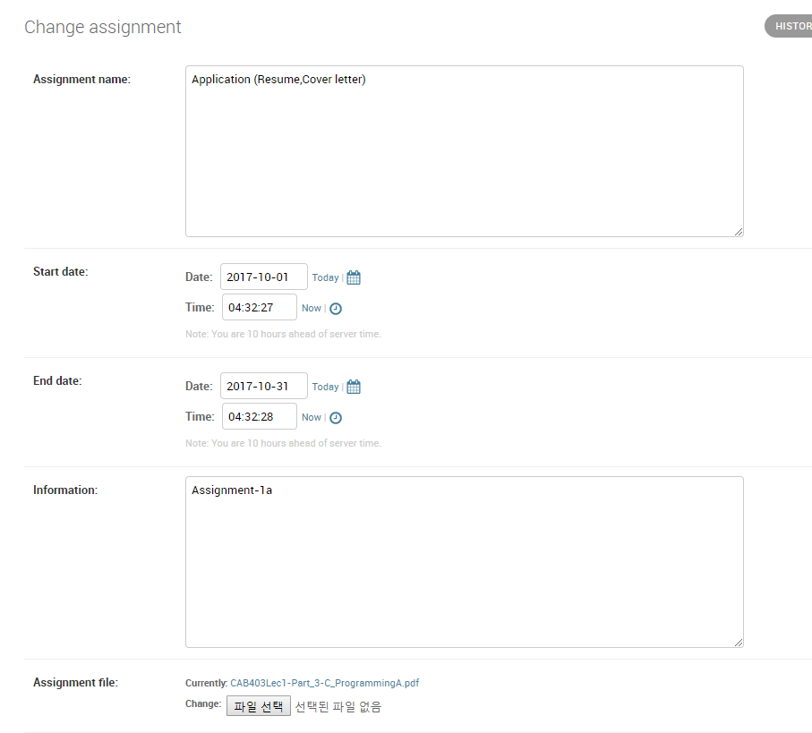
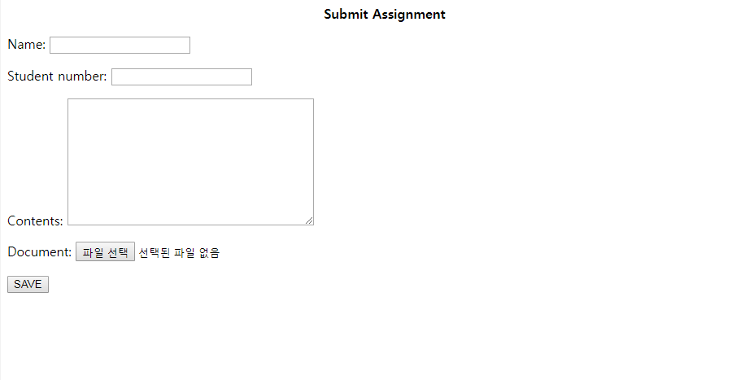
Assignment pages
Assignment Detail
Assignment Detail
Upload Assignment
Submit Assignment

Slide 23
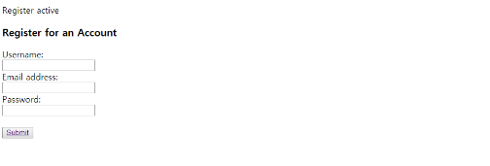
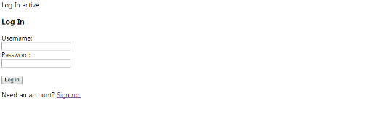
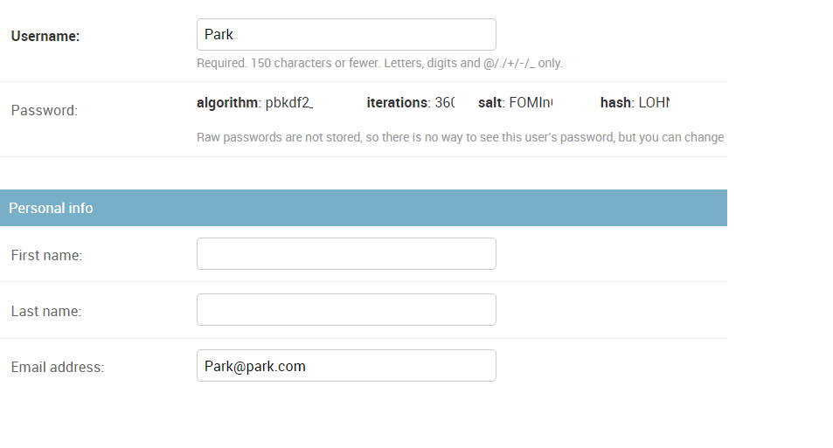
Log-in & Sign-up pages
Sign-Up
User Detail
Log-in

